Slide 1



milestone project
Crowdsourced civic
ISSUE REPORTING
system
Foundation of Artificial Intelligence Programming using Python
By Raya Singh (A25ARIU0058)
& Swarnima Singh (A25ARIU0072)

Slide 2


INTRODUCTION
Where do we actually go to complain about everyday civic issues?
Currently, there isn’t a single, simple platform where we can report everyday civic issues. People may use municipal websites, apps, or helplines, but these options are often complicated, slow, or not widely known. Because of this, many issues go unreported, and even when they are reported, there is a lack of proper tracking and response. This gap highlights the need for a more accessible and efficient system.
We have designed a crowdsourced civic issue reporting system that acts as a bridge between citizens and authorities. It is a web-based platform where people can report problems in their surroundings, and all the information collected is stored in a structured format. This data can then be monitored and managed systematically, helping in better tracking, organization, and resolution of civic issues.

Slide 3
OBJECTIVES
To develop a simple and user-friendly platform for reporting civic issues
To encourage active citizen participation through easy access
To collect and organize data in a structured format
To enable efficient tracking and management of reported issues
To provide a system that supports better decision-making through data

Slide 4
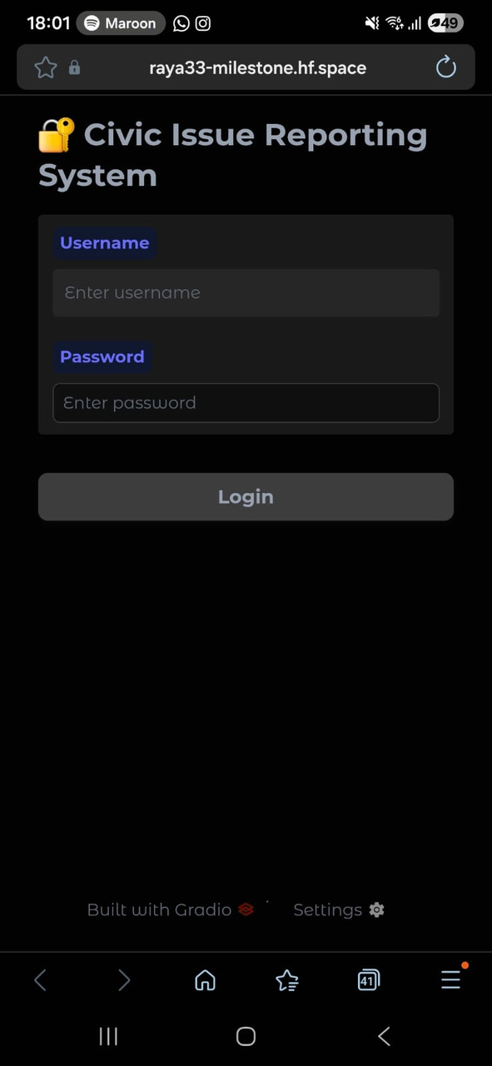

SYSTEM OVERVIEW
The system is designed as a web-based application, which means it can be accessed through a browser without requiring installation. This ensures ease of use and wider accessibility for users.
It follows a client–server interaction model, where the user (client) interacts with the interface, and the backend system processes requests, stores data, and returns responses. This structure helps in maintaining efficiency and organization.

Slide 5
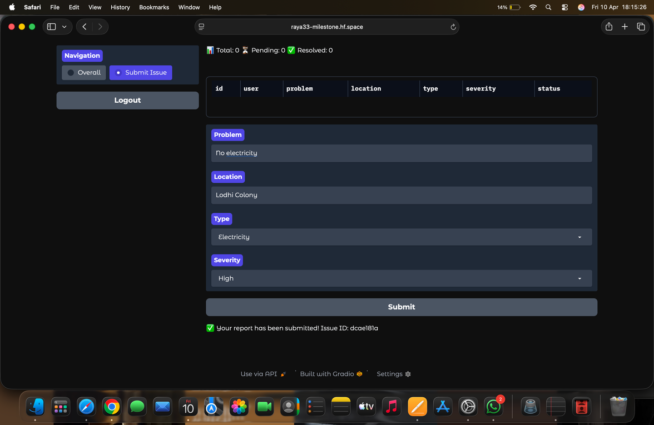
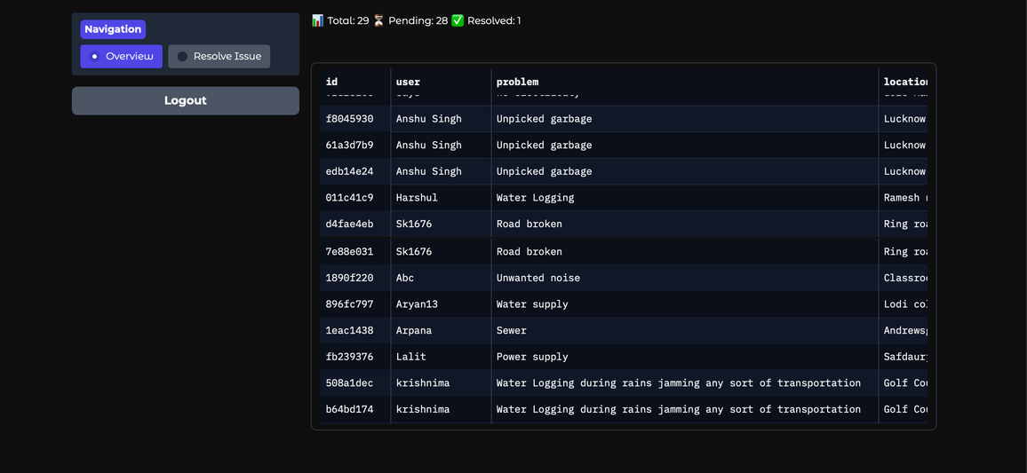
SYSTEM OVERVIEW
User Interface
Admin Interface
Allows users to report civic issues by providing necessary details such as problem type, location, and severity.
Enables administrators to view all submitted reports, manage data, and update the status of issues.

Slide 6
METHODOLOGY
The system is implemented using Python, with Gradio used to build the web-based user interface. The entire application is structured into modular functions to handle different operations such as login, data storage, issue submission, and admin control.
Data Initialization and Storage
The system uses JSON files to store:
User data
Issue reports
Preloaded data is generated using Python libraries like:
random (for generating sample values)
uuid (for unique issue IDs)
This ensures a large dataset for testing and simulation.

Slide 7
METHODOLOGY
User Authentication Logic
A login function is implemented to:
Check if the user is admin (fixed credentials)
Otherwise treat as a normal user
If a new username is entered:
i) It is automatically added to the user database
ii) This removes the need for complex authentication systems
Issue Submission Module
A function handles user input:
Problem description
Location
Type
Severity
A unique Issue ID is generated using uuid
The issue is stored in JSON with status set to “Pending”

Slide 8
METHODOLOGY
Data Processing using Pandas
JSON data is converted into a Pandas DataFrame
This allows:
Filtering user-specific data
Counting total, pending, and resolved issues
Grouping data by category and severity
Admin Control Module
Admin can:
View all reports
Search using Issue ID
Update status to “Resolved”
Changes are written back to the JSON file

Slide 9
METHODOLOGY
Data Visualization
Graphs are generated using Plotly:
Category distribution
Status (Pending vs Resolved)
Severity levels
These graphs are displayed only in the admin dashboard
User Interface (Gradio)
Navigation is handled dynamically using:
gr.State()
gr.update()
The UI is built using Gradio Blocks:
Login page
User dashboard
Admin dashboard
Components used:
Textboxes, buttons, dropdowns, tables, plots

Slide 10
METHODOLOGY
Deployment
The application is deployed on Hugging Face Spaces.
Makes the system accessible via a public web link
No installation required

Slide 11
CONCLUSIONS
The project successfully demonstrates a simple and effective platform for reporting and managing civic issues.
It enables active citizen participation by reducing the complexity of reporting problems
The system ensures structured data collection and storage, making it easier to track and manage issues.
The admin interface provides centralized control, allowing efficient monitoring and resolution of complaints.
The use of dashboards and categorization helps in better understanding and analysis of civic problems
Transparency in issue handling
Efficiency in reporting and resolution
Communication between citizens and authorities

Slide 12
FUTURE SCOPE
The system can be enhanced by integrating location-based mapping (Google Maps) to allow users to mark exact issue locations for better accuracy
Adding an image upload feature would enable users to attach photos, providing visual proof and improving the reliability of reports
The platform can be upgraded using Artificial Intelligence and Machine Learning to:
i) Automatically classify issues
ii) Identify patterns
iii) Prioritize critical problems
iv)A notification system (Email/SMS) can be implemented to:
v)Inform users about status updates
vi)Alert authorities about new issues in real time
vii)Developing a mobile application version would increase accessibility and encourage more
viii)The system can be integrated with government or municipal databases for real-world
user participation
implementation and faster resolution of issues.

Slide 13
milestone project
THANK YOU
Foundation of Artificial Intelligence Programming using Python
By Raya Singh (A25ARIU0058)
& Swarnima Singh (A25ARIU0072)

